Slide 1
CSE 205: Digital Logic Design
Prepared By,
Dr. Tanzima Hashem, Assistant Professor, CSE, BUET
Updated By,
Fatema Tuz Zohora, Lecturer, CSE, BUET

Slide 2
Registers and Counters
Clocked sequential circuits
A group of flip-flops and combinational gates.
Connected to form a feedback path.
Flip-flops + Combinational gates
(essential) (optional)
Register
A group of flip-flops.
Gates that determine how the information is transferred into the register.
Counter
A register that goes through a predetermined sequence of states.

Slide 3
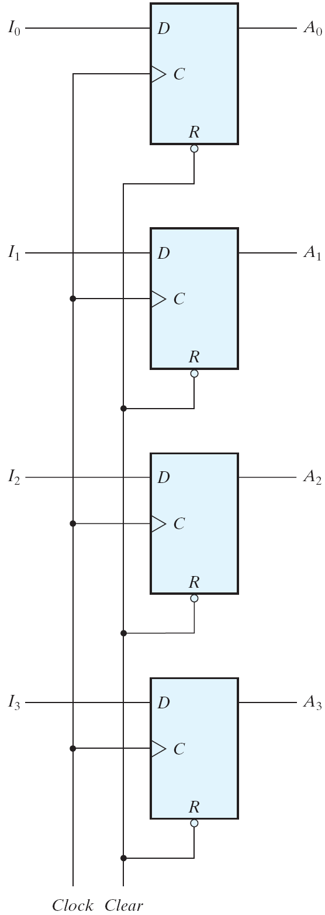
Registers
A n-bit register
n flip-flops capable of storing n bits of binary information.
4-bit register is shown in Fig. 6.1.
Clear =0 (active low); A_{x} = 0
Clock= ↑; A_{x}=I_{x}
Normal Operation; Clear =1
Fig. 6.1 Four-bit register

Slide 4
Registers
loading / updating the register: The transfer of new information into a register
Parallel loading: When all the bits of the register are loaded simultaneously with a common clock pulse
If some bits must be left unchanged,
how to do it ?
Fig. 6.1 Four-bit register

Slide 5
Registers
loading / updating the register: The transfer of new information into a register
Parallel loading: When all the bits of the register are loaded simultaneously with a common clock pulse
The inputs must be held constant
or
Clock must be inhibited
from the circuit
Fig. 6.1 Four-bit register

Slide 6
Registers
Problems:
If the inputs are hold constant
The data bus driving the register would be unavailable for other traffic.
Clock is inhibited from the circuit
Inserting gates into the clock path is bad practice
To fully synchronize the system, we must ensure that all clock pulses arrive at the same time anywhere in the system
All flipflops trigger simultaneously
Fig. 6.1 Four-bit register

Slide 7
Registers
Solution:
control the operation of the register
with the D inputs
Fig. 6.1 Four-bit register

Slide 8
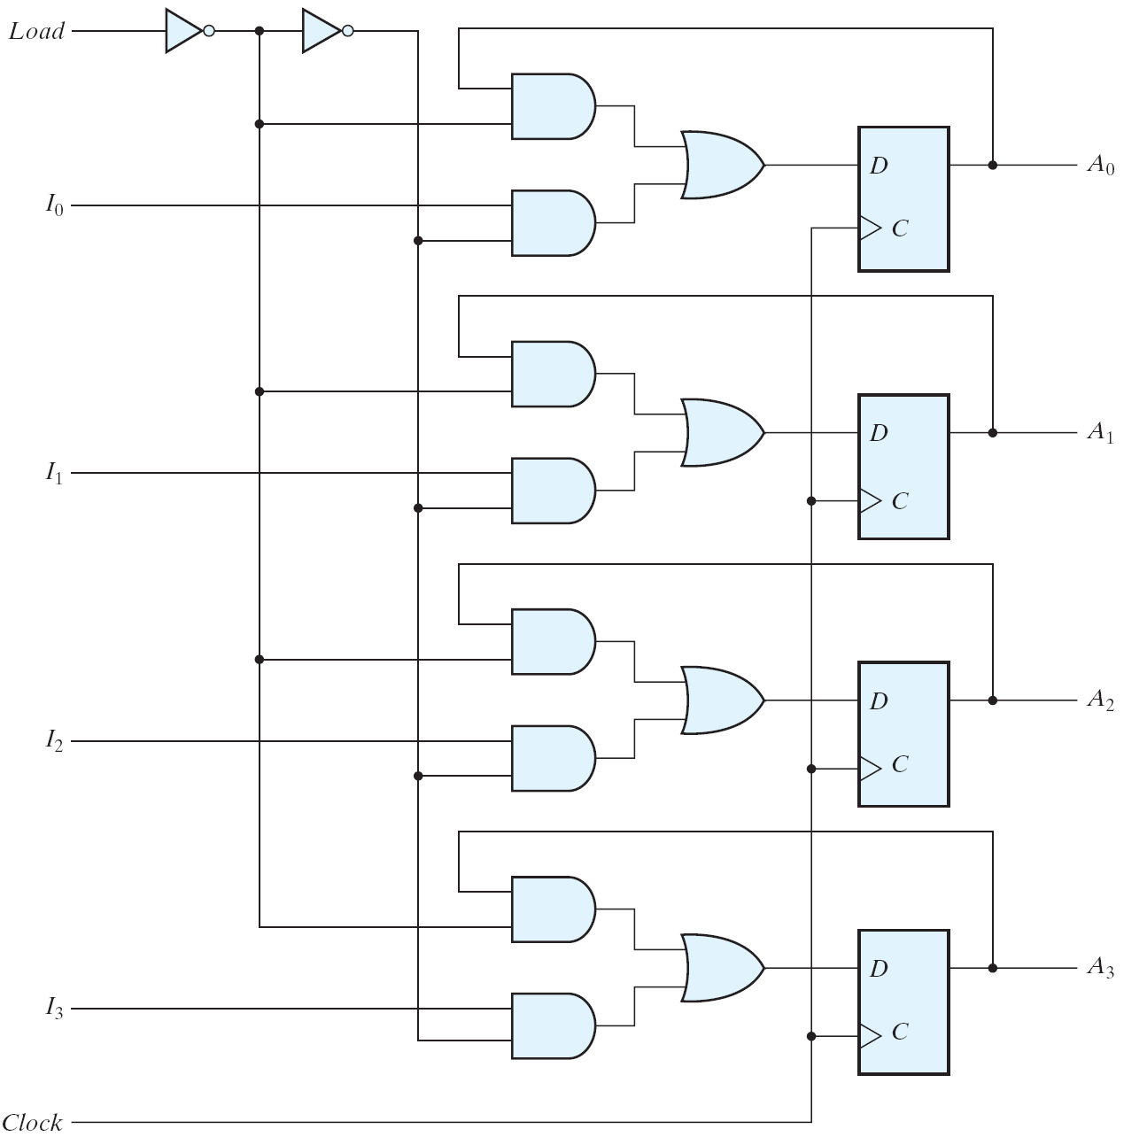
4-bit Register with Parallel Load
0
1
0
load'
1
load
0
The load input to the register determines the action to be taken with each clock pulse
1
0
1
1: Paralel load
0: No change
0
1
0
Notes:
When the load input is 1, the data at the four external inputs
are transferred into the register with the next positive edge of the clock.
When the load input is 0, the outputs of the flipflops are connected to their respective inputs.

Slide 9
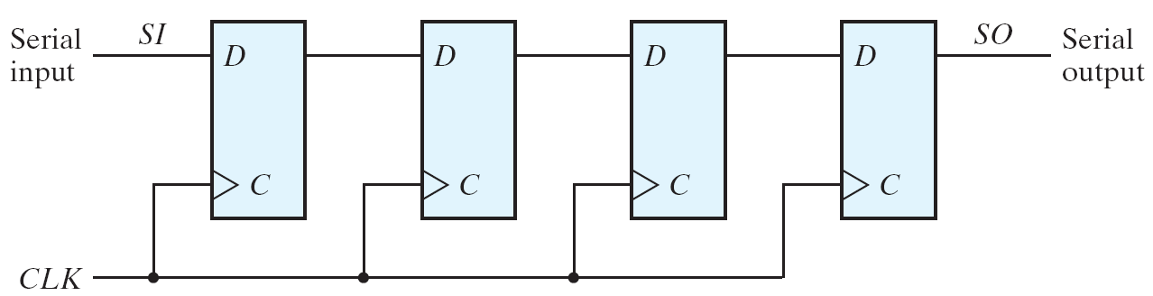
Shift Registers
A register capable of shifting the binary information held in each cell to its neighbouring cell, in a selected direction is called a shift register.
Clock controls the shift operation
1
0
1
1
0
1
1
0
1
1
Four-bit shift register

Slide 10
Data Transfer
Serial transfer vs. Parallel transfer
Serial transfer
Information is transferred one bit at a time.
Shifts the bits out of the source register into the destination register.
Parallel transfer
All the bits of the register are transferred at the same time.

Slide 11
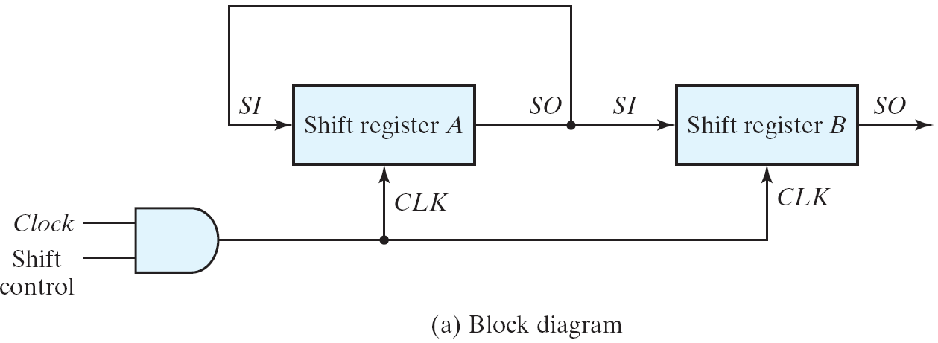
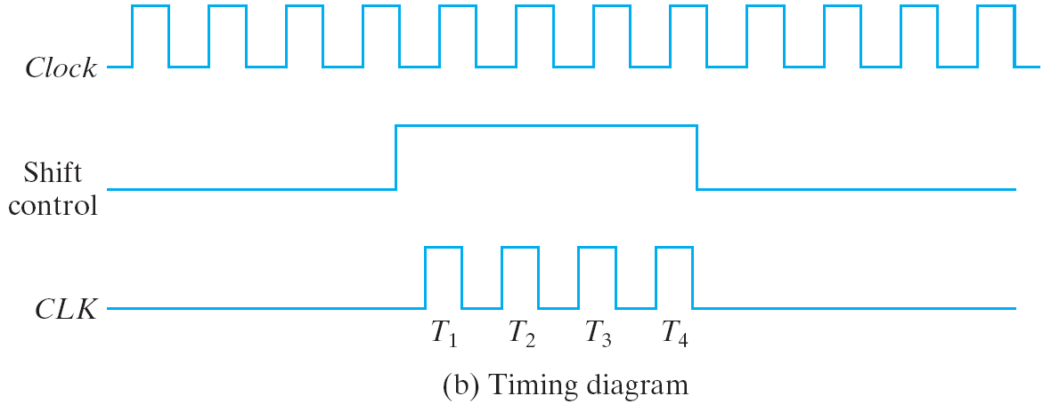
Serial transfer from reg A to reg B
Synchronous
Fig. 6.4 Serial transfer from register A to register B

Slide 12
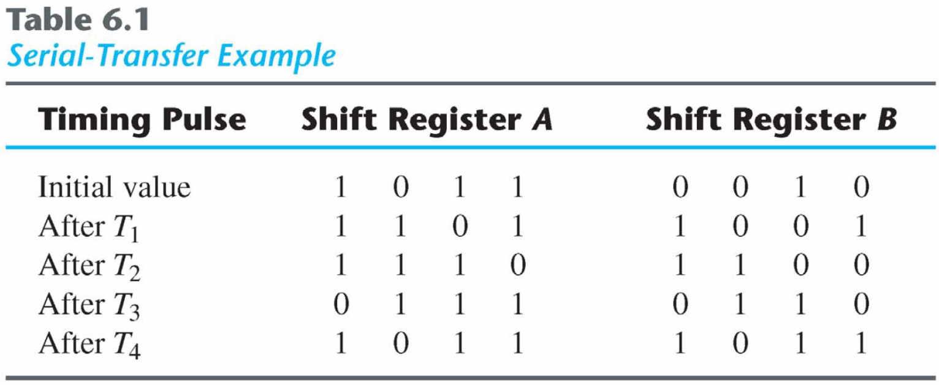
Serial transfer from reg A to reg B
serial-transfer

Slide 13
Serial Addition
Parallel adders
Faster,
cost more logic
Serial adders
Slower
n-bit addition n clock cycles
Less hardware

Slide 14
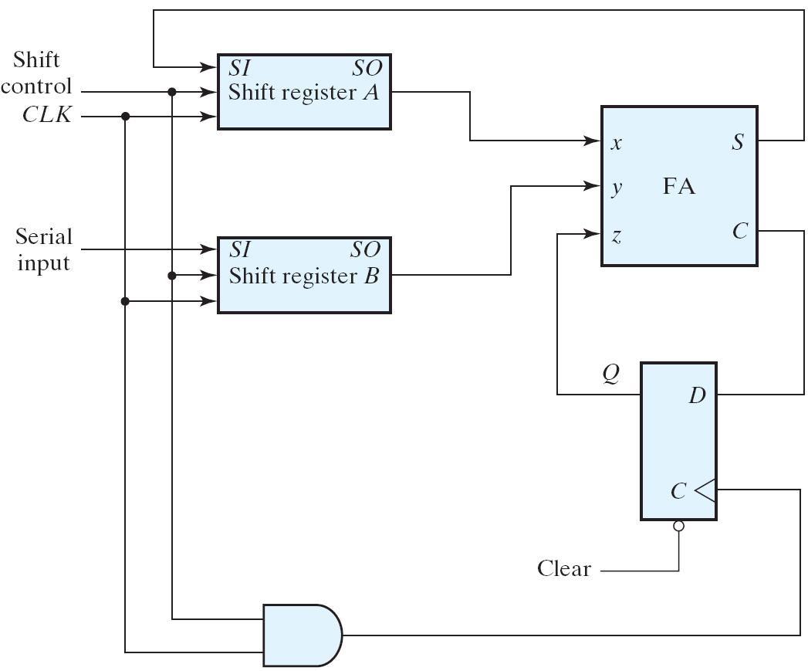
Serial Addition using D Flip-Flops
1
0
0101
0
0
0010
1
1
0
1
1
1
0011
?001
Fig. 6.5 Serial adder

Slide 15
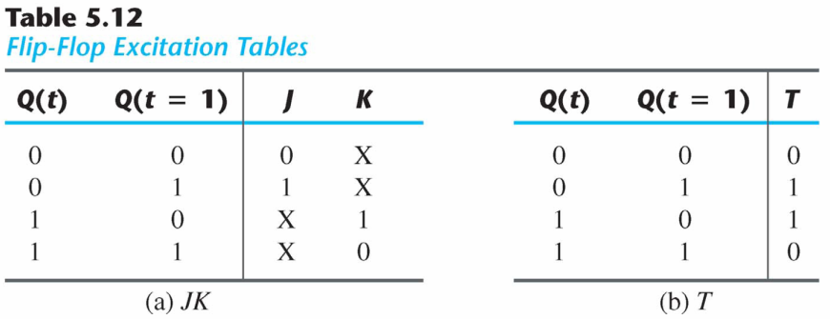
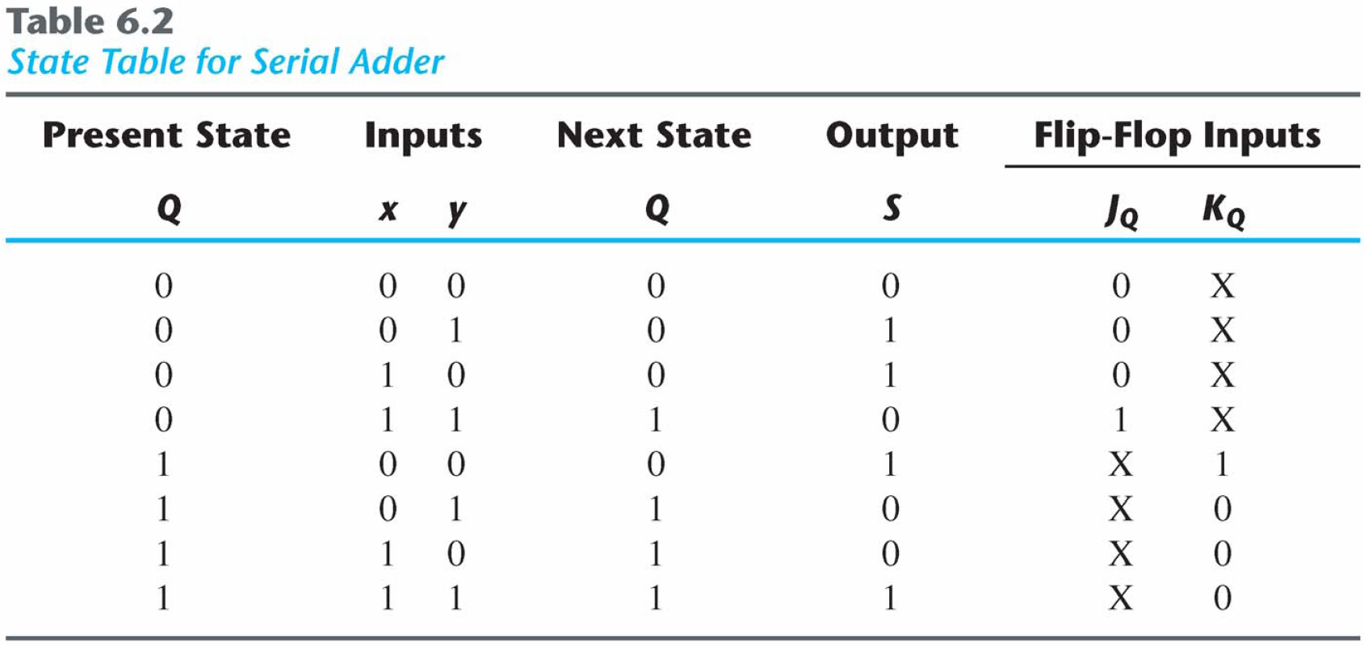
Serial Adder using JK FFs (1/2)
Serial adder using JK flip-flops

Slide 16
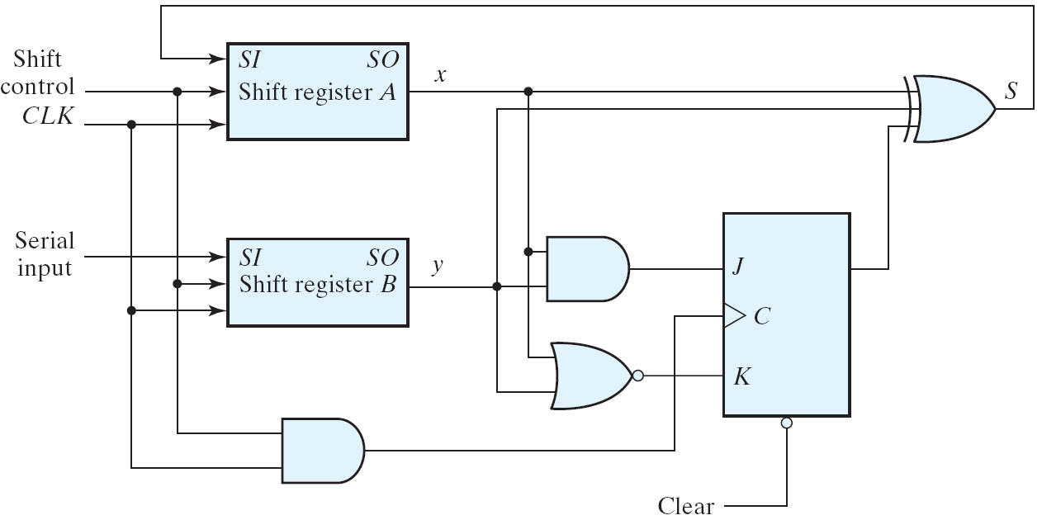
Serial Adder using JK FFs (2/2)
Circuit diagram
J_{Q} = xy K_{Q} = x′y′ = (x+y)′
S = x ⊕ y ⊕ Q
C_{i}
Fig. 6.6 Second form of serial adder

Slide 17
Universal Shift Register
Three types of shift register
Unidirectional shift register
A register capable of shifting in one direction.
Bidirectional shift register
A register can shift in both directions.
Universal shift register
Has both direction shifts & parallel load/out capabilities.

Slide 18
Universal Shift Register (1/4)
Capability of a universal shift register:
A clear control to clear the register to 0;
A clock input to synchronize the operations;
A shift-right control to enable the shift right operation and the serial input and output lines associated w/ the shift right;
A shift-left control to enable the shift left operation and the serial input and output lines associated w/ the shift left;
A parallel-load control to enable a parallel transfer and the n parallel input lines associated w/ the parallel transfer;
n parallel output lines;
A control state that leaves the information in the register unchanged in the presence of the clock;

Slide 19
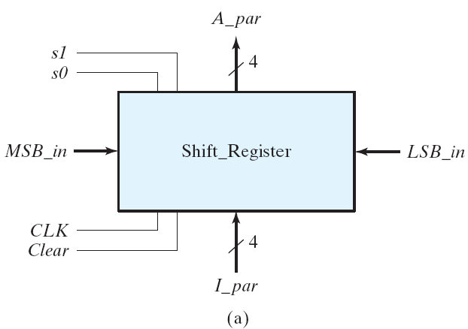
Universal Shift Register (2/4)
Example: 4-bit universal shift register
Fig. 6.7 Four-bit universal shift register

Slide 20
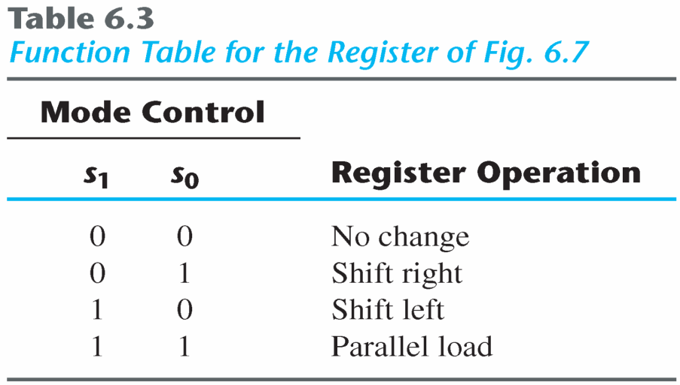
Universal Shift Register (3/4)
Function Table
Clear | S1 | S0 | A3+ | A2+ | A1+ | A0+ | (operation)
0 | × | × | 0 | 0 | 0 | 0 | Clear
1 | 0 | 0 | A3 | A2 | A1 | A0 | No change
1 | 0 | 1 | sri | A3 | A2 | A1 | Shift right
1 | 1 | 0 | A2 | A1 | A0 | sli | Shift left
1 | 1 | 1 | I3 | I2 | I1 | I0 | Parallel load

Slide 21
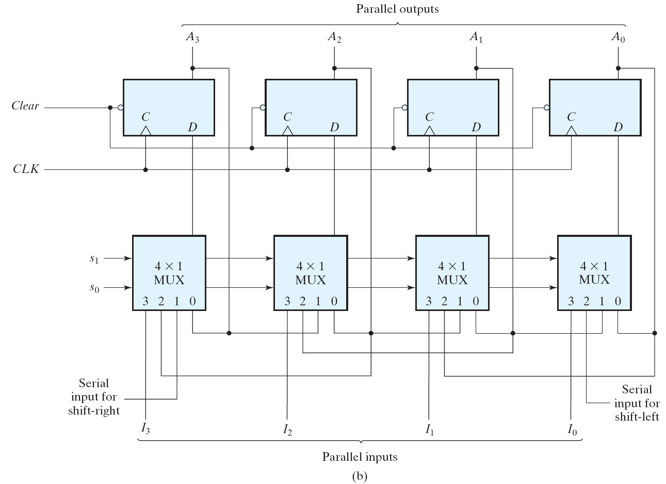
Universal Shift Register (4/4)
Fig. 6.7 Four-bit universal shift register

Slide 22
Counters
Counter : A register that goes through a prescribed sequence of states.
Special purpose arithmetic circuits used for the purpose of counting
The sequence of states: may follow the binary number sequence (⇒ Binary counter) or any other sequence of states (e.g., Gray Code).
Counter circuits server many purposes
Count occurrences of certain events
Generate timing intervals for controlling various tasks in a digital system
Track elapsed time between events

Slide 23
Counters
Categories of counters
Asynchronous counters (Ripple counters) The flip-flops within the counter do not change state at the same time
The flip-flop output transition serves as a source for triggering other flip-flop.
⇒ no common clock pulse.
Synchronous counters
The CLK inputs of all flip-flops receive a common clock.

Slide 24
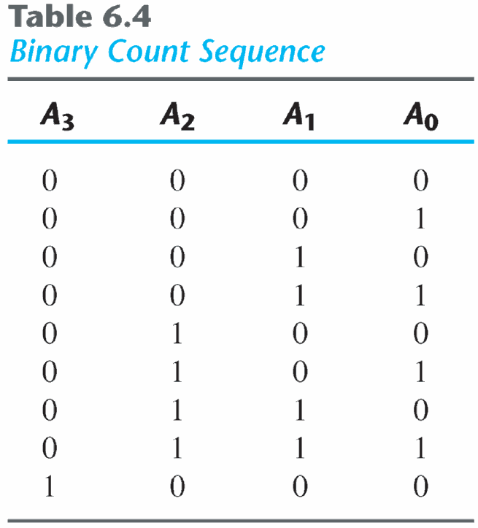
Binary Ripple Counter
A n-bit binary counter → n FFs → count from 0 to 2^{n}-1.
Example: 4-bit binary ripple counter
Binary count sequence: 4-bit

Slide 25
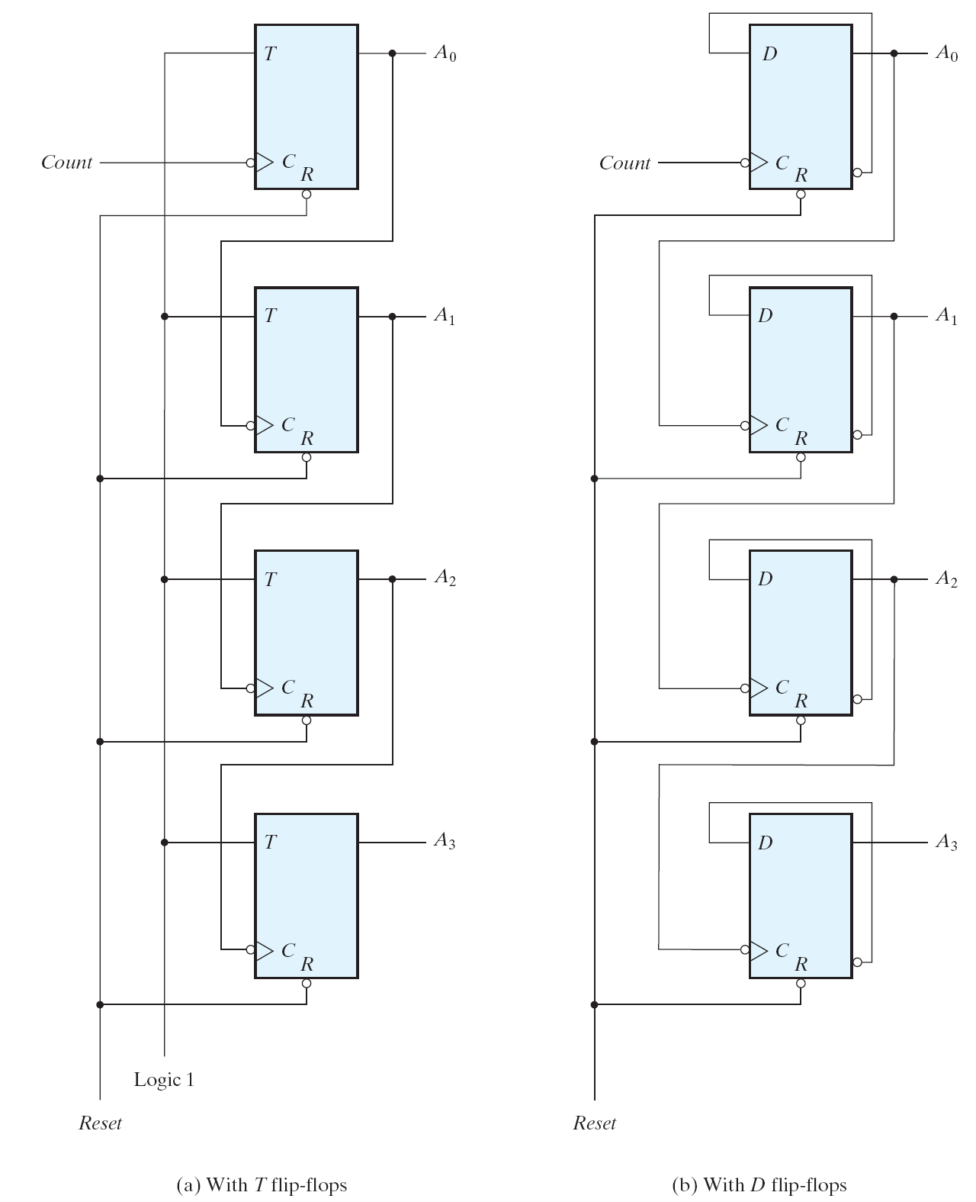
Binary Ripple Counter
Reset signal sets all outputs to 0
Negative edge triggered
Count signal toggles output of low-order flip flop
Low-order flip flop provides trigger for adjacent flip flop
Output of one flipflop → Clock to the next
Not all flops change value simultaneously
Lower-order flops change first

Slide 26
Binary Ripple Counter
A₃ | A₂ | A₁ | A₀
0 | 0 | 0 | 0
0 | 0 | 0 | 1
0 | 0 | 1 | 0
0 | 0 | 1 | 1
0 | 1 | 0 | 0
0 | 1 | 0 | 1
0 | 1 | 1 | 0
0 | 1 | 1 | 1
1 | 0 | 0 | 0
Ripper propagation
Ripper propagation
Fig. 6.8 Four-bit binary ripple counter

Slide 27
Asynchronous (Ripple) Counters
Asynchronous counters are commonly referred as ripple counters
The effect of the input clock pulse is first felt by the first flip-flop FF0.
The effect cannot get to the next flip-flop FF1 immediately as there is a propagation delay through FF0
Then there is a propagation delay through FF1 before the next flip-flop FF2 is triggered
Thus, the effect of an input clock pulse “ripples” through the counter, taking some time, due to propagation delays, to reach the last flip-flop.

Slide 28
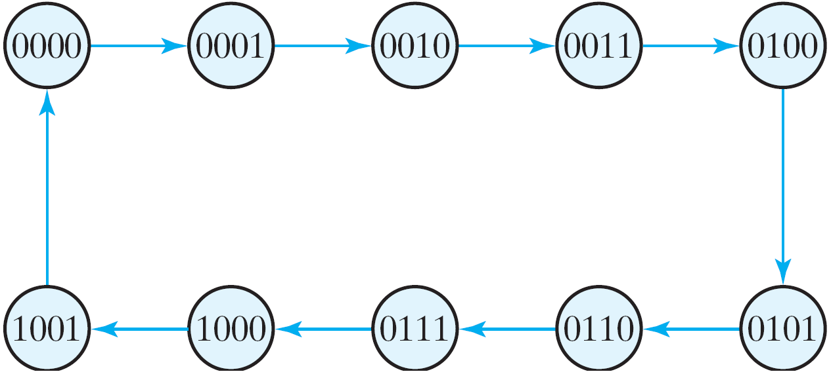
BCD Ripple Counter
Counter must reset itself after counting the terminal count
Fig. 6.9 State diagram of a decimal BCD counter

Slide 29
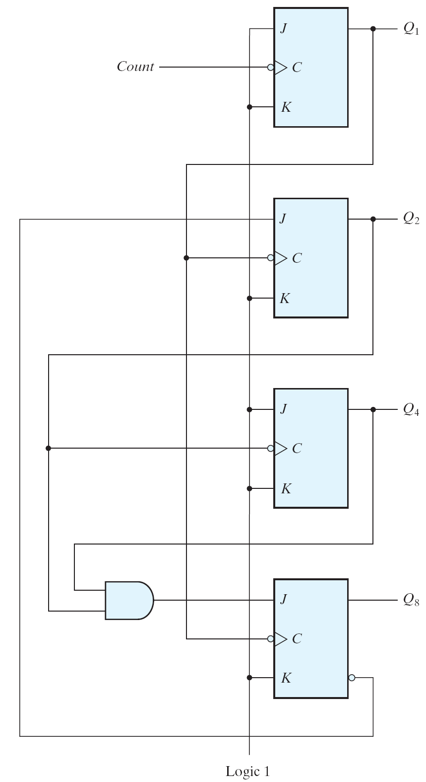
BCD Ripple Counter
Q₈ | Q₄ | Q₂ | Q₁
0 | 0 | 0 | 0
0 | 0 | 0 | 1
0 | 0 | 1 | 0
0 | 0 | 1 | 1
0 | 1 | 0 | 0
0 | 1 | 0 | 1
0 | 1 | 1 | 0
0 | 1 | 1 | 1
1 | 0 | 0 | 0
1 | 0 | 0 | 1
Fig. 6.10 BCD ripple counter

Slide 30
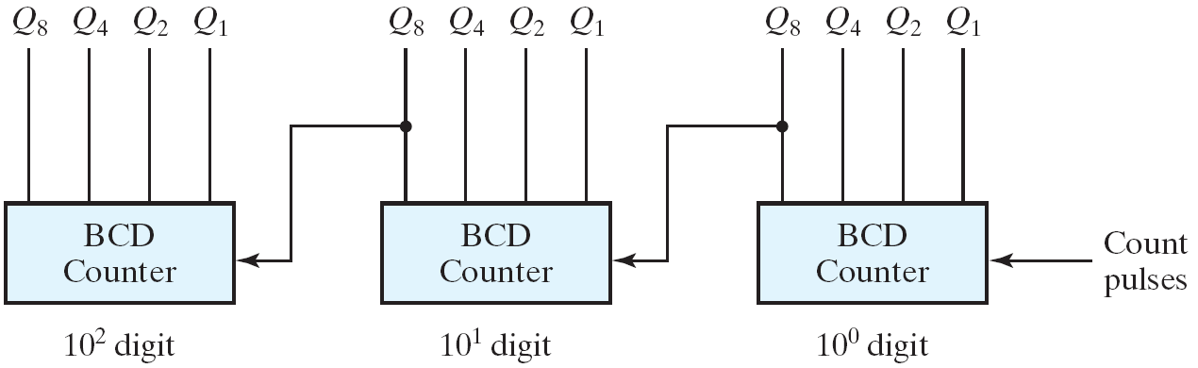
BCD Ripple Counter
Three-decade BCD counter
Fig. 6.11 Block diagram of a three-decade decimal BCD counter

Slide 31
Synchronous Counters
All of the FFs are triggered simultaneously by the clock input pulses.
All FFs change at same time
Synchronous counters can be designed using sequential circuit procedure

Slide 32
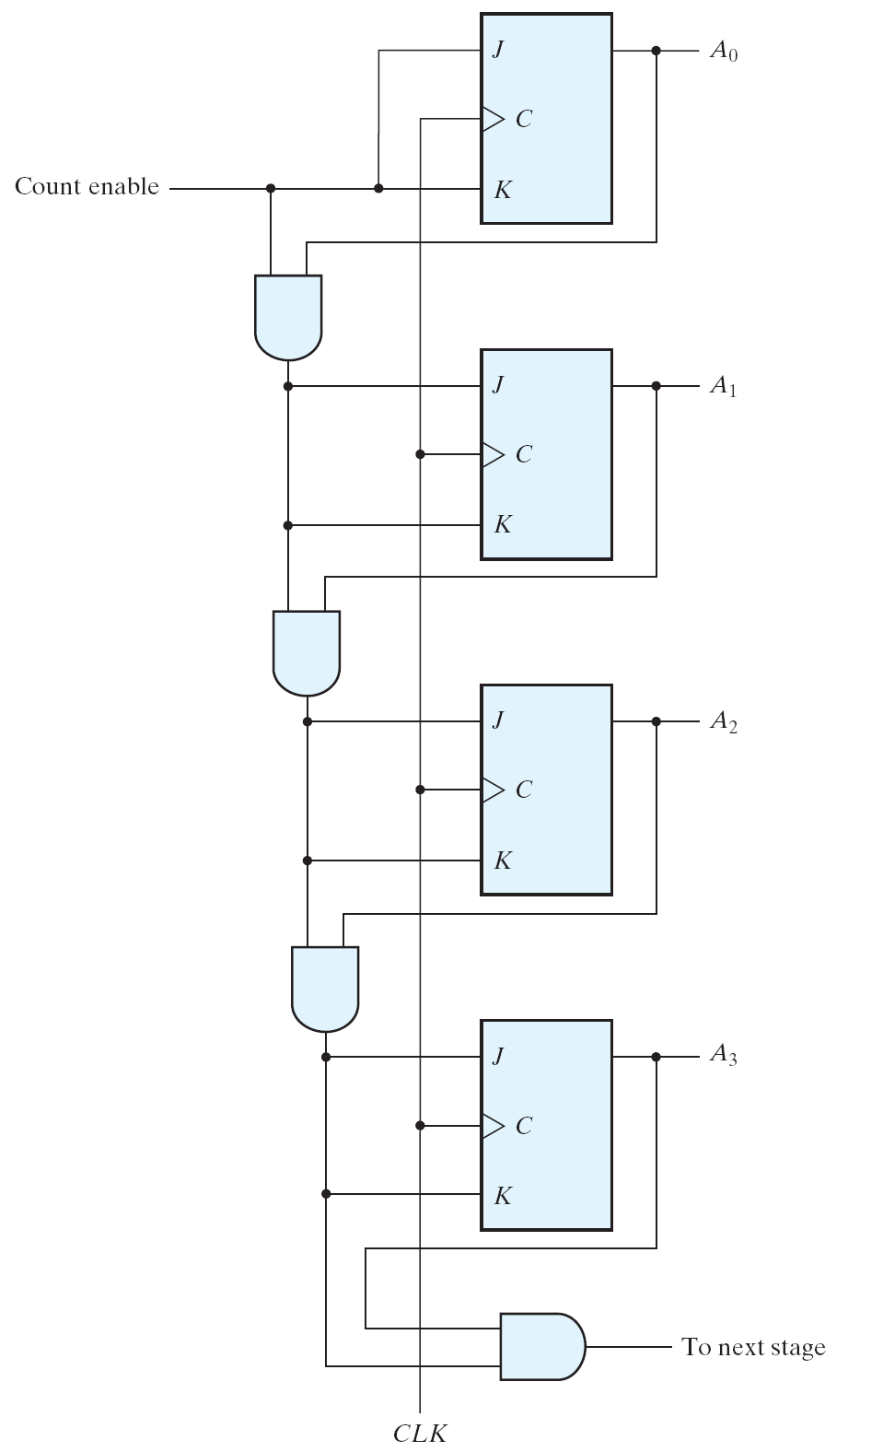
4-Bit Binary Counter
Value increments on positive edge
J=K=0,
→ no change;
J=K=1,
→complement.
A₃ | A₂ | A₁ | A₀
0 | 0 | 0 | 0
0 | 0 | 0 | 1
0 | 0 | 1 | 0
0 | 0 | 1 | 1
0 | 1 | 0 | 0
0 | 1 | 0 | 1
0 | 1 | 1 | 0
0 | 1 | 1 | 1
1 | 0 | 0 | 0
1 | 0 | 0 | 1
1 | 0 | 1 | 0
1 | 0 | 1 | 1
1 | 1 | 0 | 0
1 | 1 | 0 | 1
1 | 1 | 1 | 0
1 | 1 | 1 | 1
C_en A₀
C_en A₀ A₁
C_en A₀ A₁ A₂

Slide 33
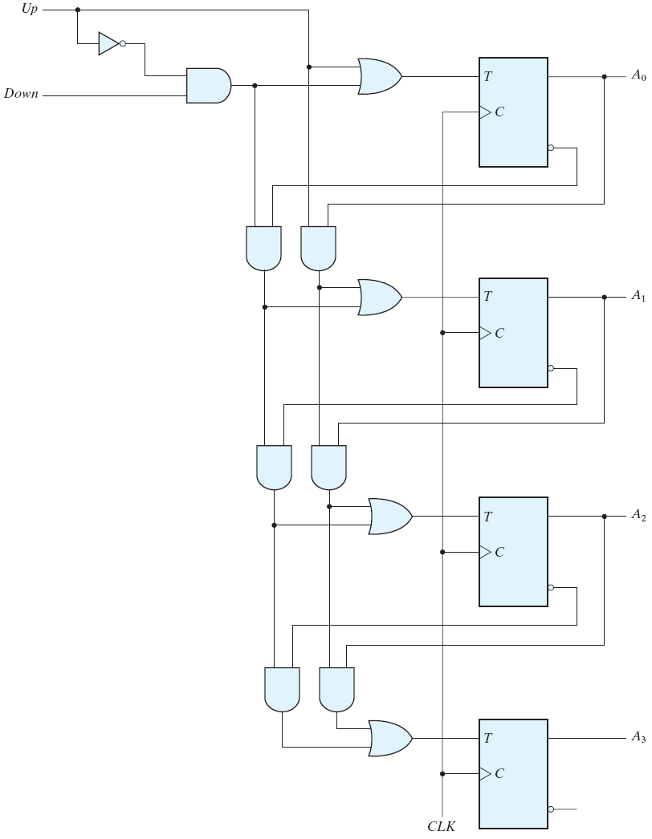
4-bit Up/Down Binary Counter
Up | Down | Function
0 | 0 | No change
0 | 1 | Down Count
1 | 0 | Up Count
1 | 1 | Up Count
down
up
down A'₀
up A₀
A₃ | A₂ | A₁ | A₀
0 | 0 | 0 | 0
0 | 0 | 0 | 1
0 | 0 | 1 | 0
0 | 0 | 1 | 1
0 | 1 | 0 | 0
0 | 1 | 0 | 1
0 | 1 | 1 | 0
0 | 1 | 1 | 1
1 | 0 | 0 | 0
1 | 0 | 0 | 1
1 | 0 | 1 | 0
1 | 0 | 1 | 1
1 | 1 | 0 | 0
1 | 1 | 0 | 1
1 | 1 | 1 | 0
1 | 1 | 1 | 1
down A'₀ A'₁
up A₀ A₁
down A'₀ A'₁ A'₂
up A₀ A₁ A₂

Slide 34
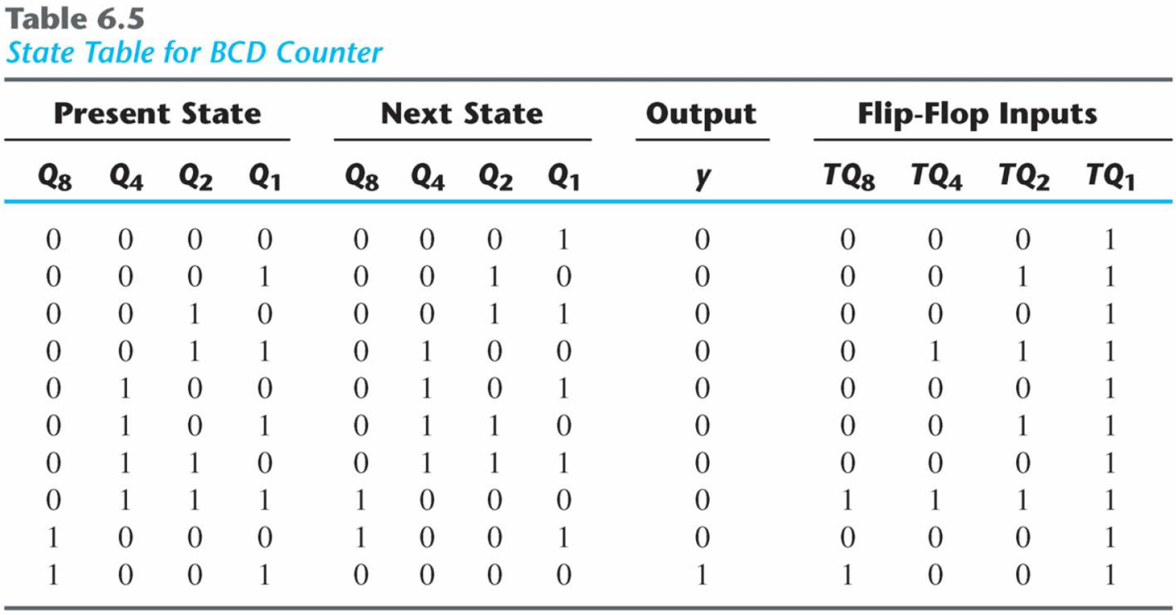

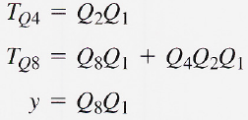
BCD Counters
Simplified functions

Slide 35
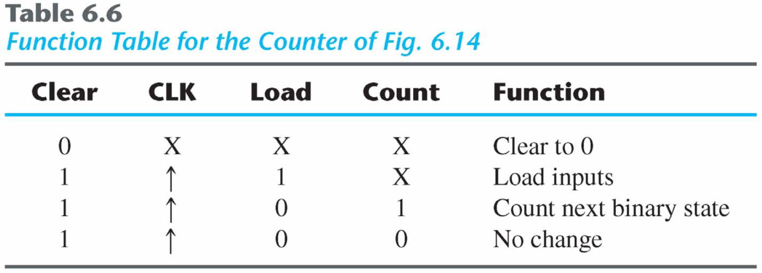
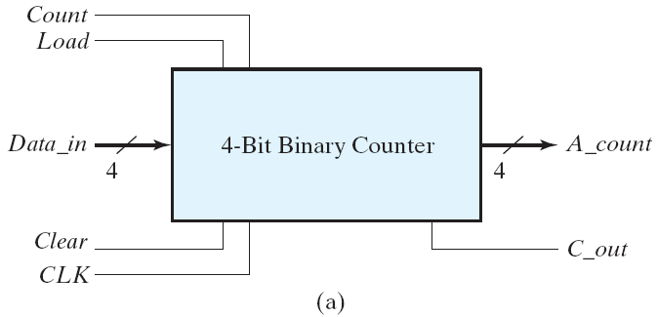
4-bit binary counter with parallel load
Fig. 6.14 Four-bit binary counter with parallel load

Slide 36
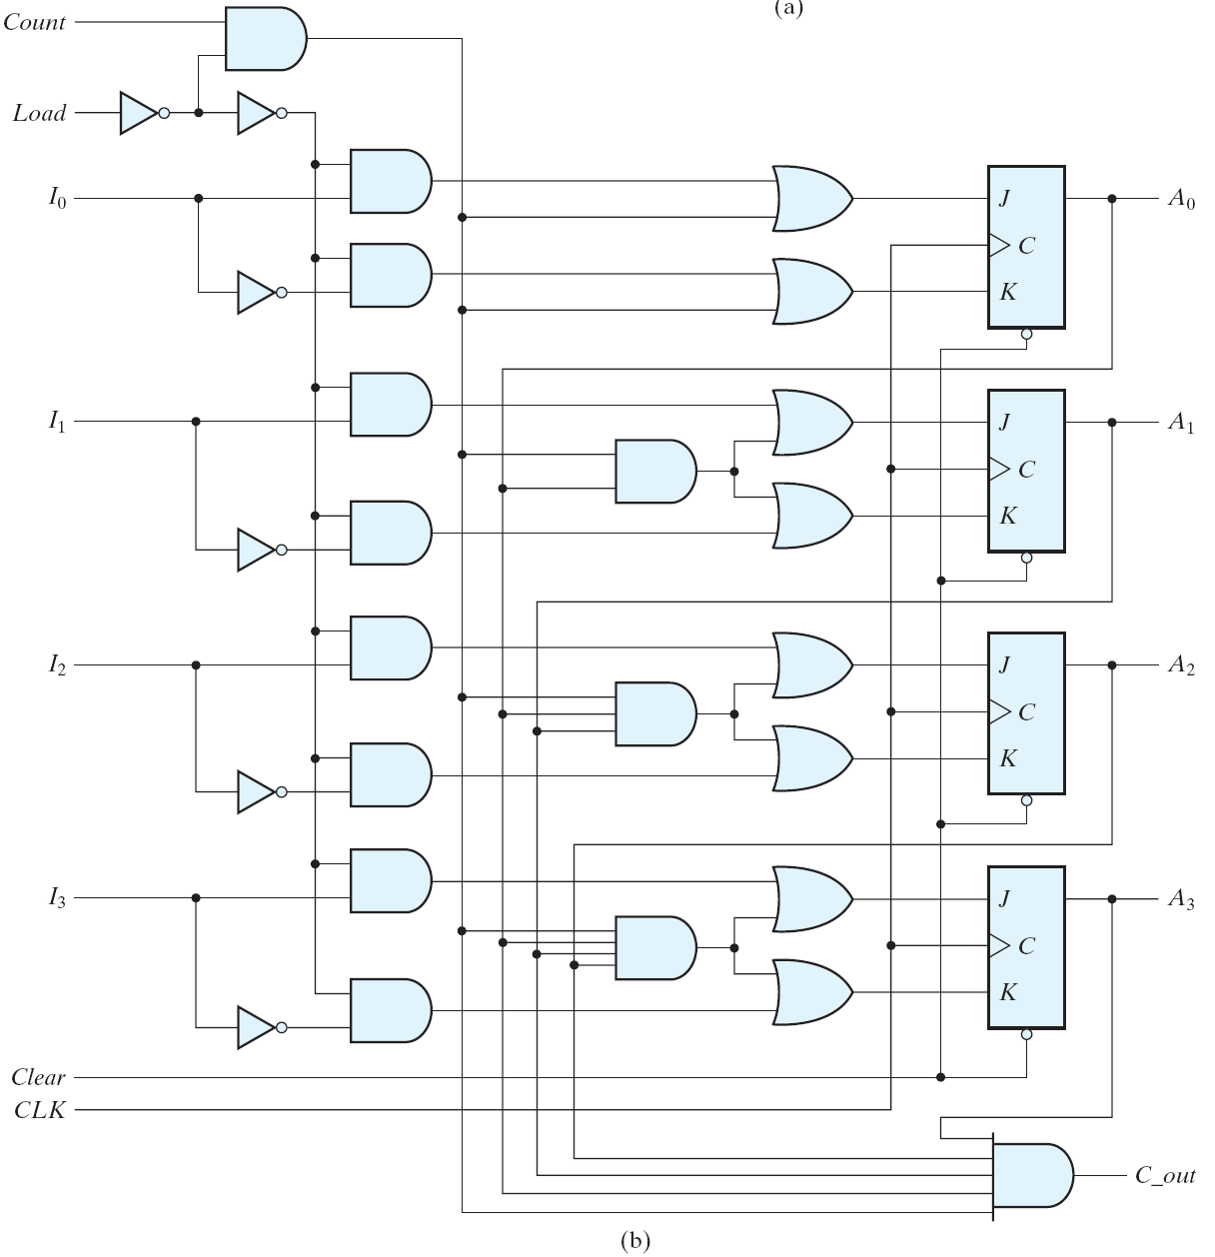
count load'
load
c_en
c_en A₀
async
Fig. 6.14
Four-bit binary counter with parallel load

Slide 37
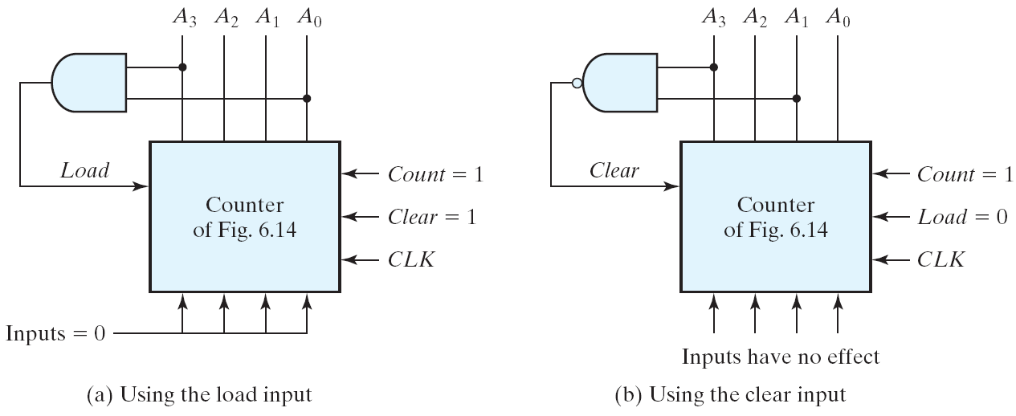
BCD counter using a counter with parallel load
Generate any count sequence
E.g.: BCD counter ⇐ Counter with parallel load
Fig. 6.15 Two ways to achieve a BCD counter using a counter with parallel load

Slide 38
Other Counters
Counters
Can be designed to generate any desired sequence of states.
Divide-by-N counter (modulo-N counter)
A counter that goes through a repeated sequence of N states.
The sequence may follow the binary count or may be any other arbitrary sequence.

Slide 39
Counter with unsigned states
A circuit with n flip-flops has 2^{n} states
We may have to design a counter with a given sequence (unused states)
Unused states may be treated as don’t care or assigned specific next state
Outside noise may cause the counter to enter unused state
Must ensure counter eventually goes to the valid state

Slide 40
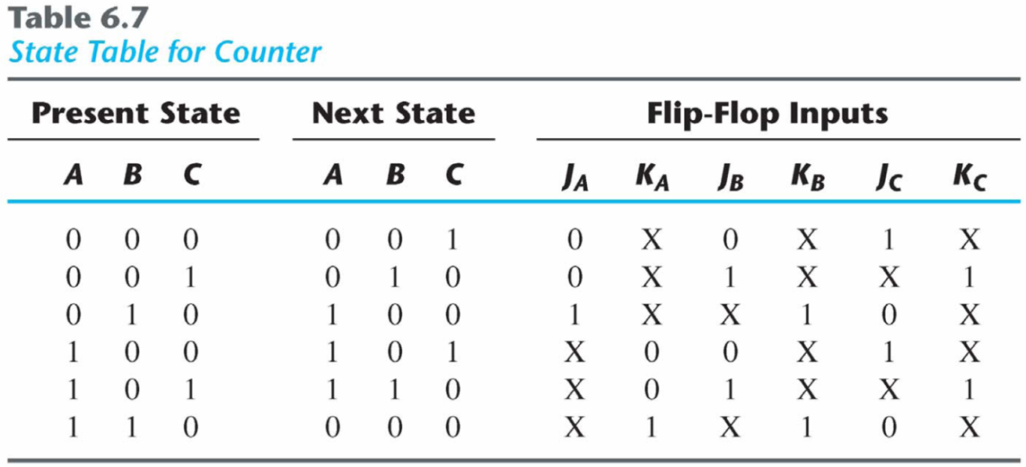
Counter with unsigned states
An example
Two unused states: 011 & 111
The simplified flip-flop input equations:
J_{A} = B, K_{A} = B
J_{B} = C, K_{B} = 1
J_{C} = B′, K_{C} = 1

Slide 41
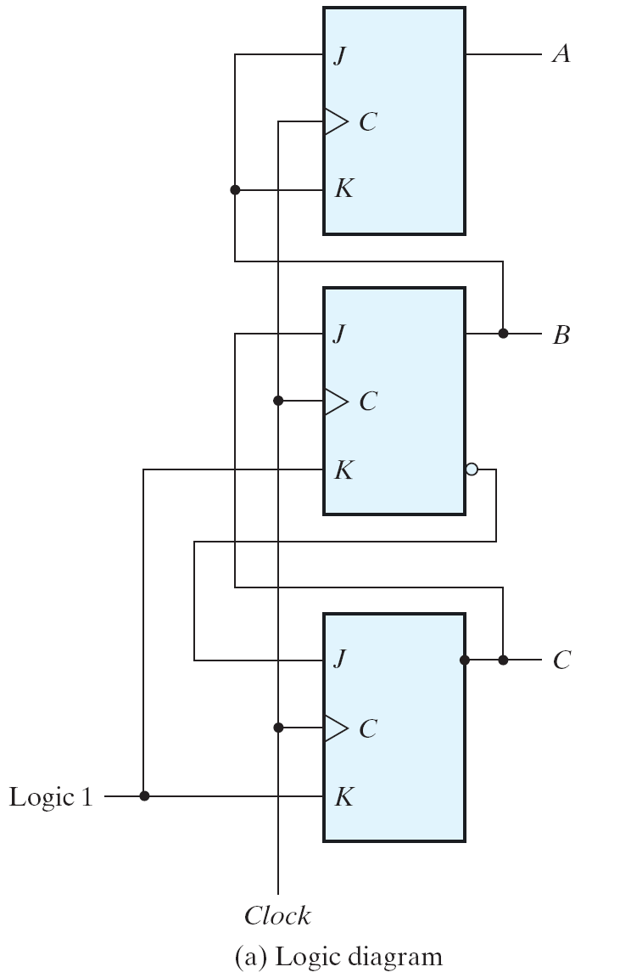
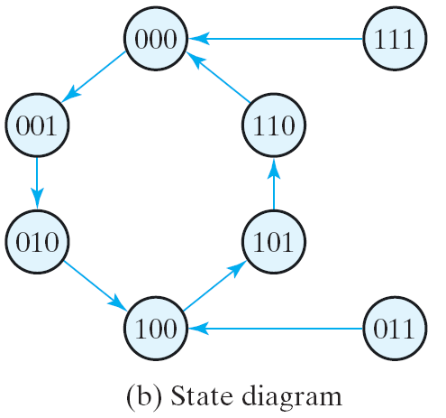
Counter with unsigned states
The simplified flip-flop input equations:
J_{A} = B, K_{A} = B
J_{B} = C, K_{B} = 1
J_{C} = B′, K_{C} = 1

Slide 42
Ring counter
A circular shift register with only one flip-flop being set at any particular time, all others are cleared (initial value = 1 0 0 … 0 ).
The single bit is shifted from one flip-flop to the next to produce the sequence of timing signals.

Slide 43
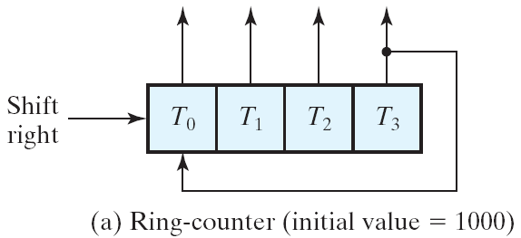
Ring counter
A 4-bit ring counter
A3 | A2 | A1 | A0
1 | 0 | 0 | 0
0 | 1 | 0 | 0
0 | 0 | 1 | 0
0 | 0 | 0 | 1
1 | 0 | 0 | 0
Fig. 6.17 Generation of timing signals

Slide 44
Ring counter
Application of counters
Counters may be used to generate timing signals to control the sequence of operations in a digital system.
Approaches for generation of 2^{n} timing signals
1. A shift register with 2^{n} flip-flops
2. An n-bit binary counter together with an n-to-2^{n}-line decoder

Slide 45
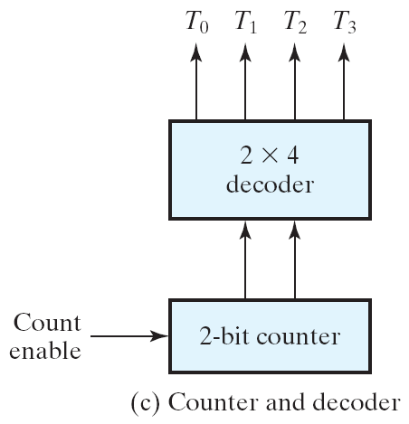
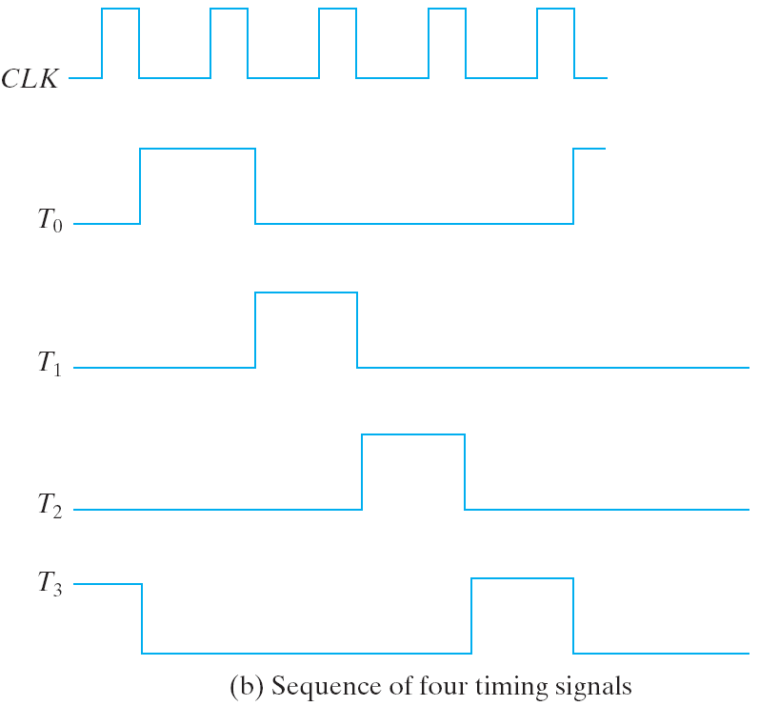
Generation of timing signals
Fig. 6.17 Generation of timing signals

Slide 46
Ring counter vs. Switch-tail ring counter
Ring counter
A k-bit ring counter circulates a single bit among the flip-flops to provide k distinguishable states.
Switch-tail ring counter
It is a circular shift register with the complement output of the last flip-flop connected to the input of the first flip-flop.
A k-bit switch-tail ring counter will go through a sequence of 2k distinguishable states. (initial value = 0 0 … 0).

Slide 47
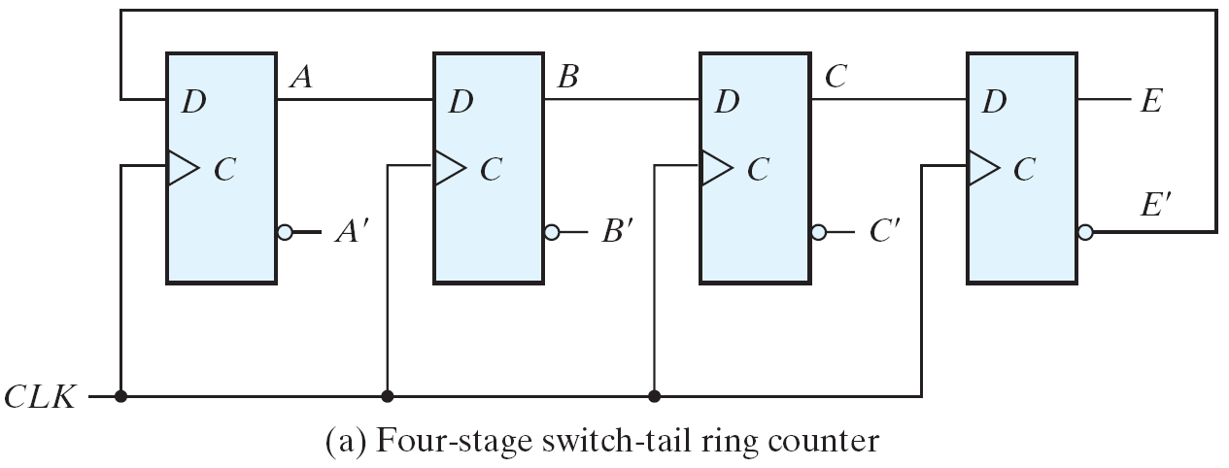
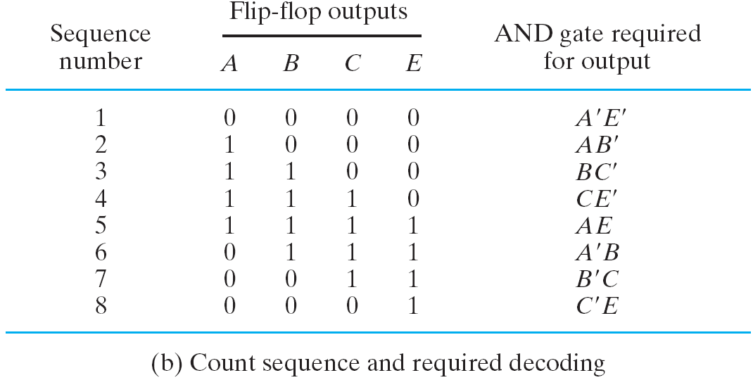
An example: Switch-tail ring counter

Slide 48
Johnson counter
A k-bit switch-tail ring counter + 2k decoding gates
Provide outputs for 2k timing signals
E.g.: 4-bit Johnson counter
The decoding follows a regular pattern
2 inputs per decoding gate

Slide 49
Summary
Disadvantage of the switch-tail ring counter
If it finds itself in an unused state, it will persist to circulate in the invalid states and never find its way to a valid state.
One correcting procedure: D_{C} = (A + C) B
Summary
Johnson counters can be constructed for any number of timing sequences
Number of flip-flops = 1/2 (the number of timing signals).
Number of decoding gates = number of timing signals 2-input per gate.

Slide 50
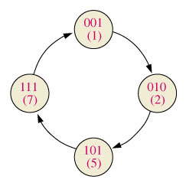
Practice: counter with irregular binary count sequence
Present State Q2 Q1 Q0 | Next State Q2 Q1 Q0
0 0 1 | 0 1 0
0 1 0 | 1 0 1
1 0 1 | 1 1 1
1 1 1 | 0 0 1
Output Transitions QN QN+1 | Flip-Flop Inputs J K
0 → 0 | 0 x
0 → 1 | 1 x
1 → 0 | x 1
1 → 1 | x 0

Slide 51
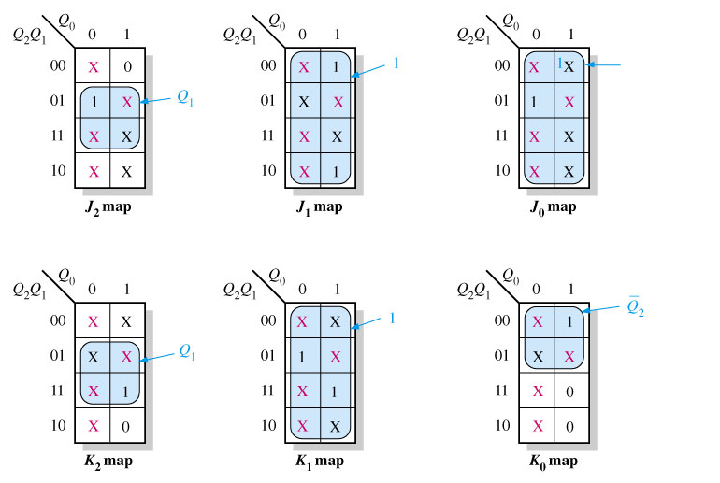

Slide 52
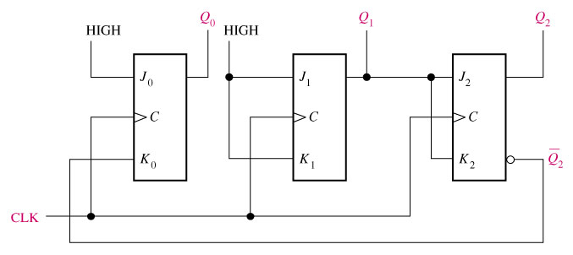
J0 = 1, K = Q2
J1 = K1 = 1
J2 = K2 = Q1

Slide 53
An analysis shows that if the counter, by accident, gets into one of the invalid states (0, 3, 4, 6) it will always return to a valid state according to the following sequences: 0→3→4→7 and 6→1.

